Slide 1

Money Honey Financial Services Pvt. Ltd.
Large Cap Mutual Fund

Slide 2
Table Of Content
Why Large cap funds are truly larger?
What are Large cap funds?
Features of Large cap funds
Performance history
Who should invest in large cap funds?
Why invest in large cap fund?
Large cap risk and potential return
Difference between large cap / mid cap / small cap
SIP or Lump sum
Tax implication

Slide 3


Large cap funds
An open-ended equity scheme predominantly investing in large cap stocks.

Slide 4
1. Why Large cap funds are truly larger?

Slide 5
Why Large cap funds are truly larger?
Large cap fund
Top 1 to 100 NSE listed Co.'s.
Top 3 Largest companies.
Reliance Industries Ltd
TCS
HDFC Bank Ltd
Largest large cap co. is almost 36x larger than largest mid Cap co.
Largest large cap co. is almost 105x larger than largest small cap co.
These are biggest brands in our country

Slide 6
2. What are Large cap funds?

Slide 7

What are Large cap funds?
Large Cap funds invest major proportion of their assets in equity shares of large market capitalization Co.s.
Those co.'s. which comes under large cap bracket have a high reputation in the market.
With the best Large Cap funds, investors can be assured that they are investing in companies that have an excellent track record of performing well in medium to long term horizon.

Slide 8
3. Features of Large cap funds

Slide 9
Features of large cap funds
Stable, mature, proven track record, rules the market.
Have reputation, quality & reliability in the market.
Tend to less affected in slowdown.
Large cap funds are more secure investments compared to small cap and mid cap.
Tend to be less volatile during market fluctuations.

Slide 10
4. Performance history

Slide 11
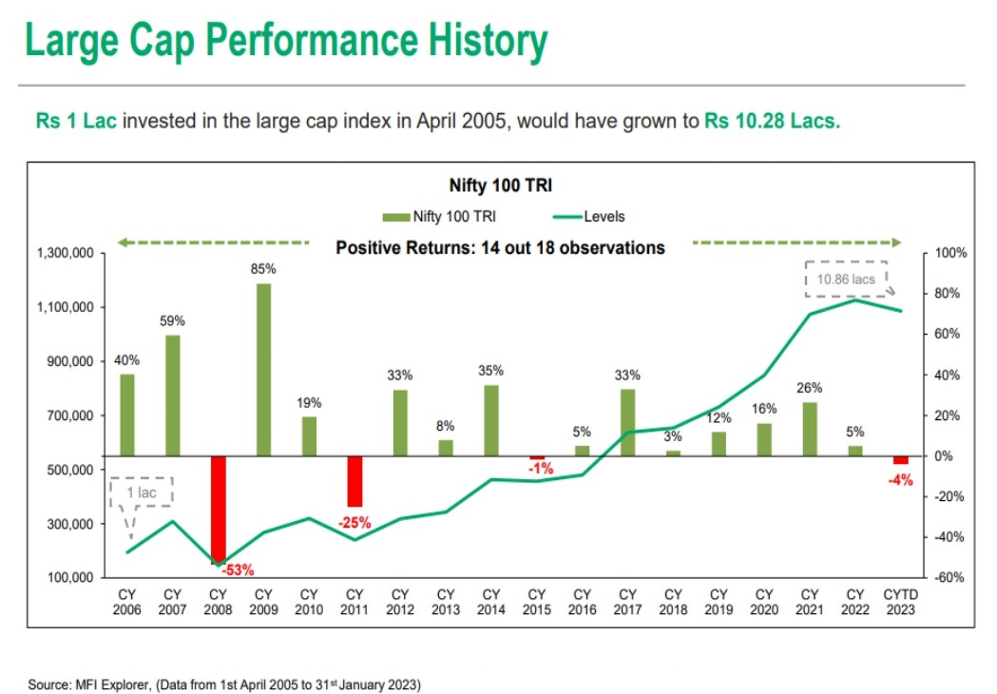
Large cap performance history
Notes:
Data from Baroda BNP Paribas Large Cap Fund- Jan 2023

Slide 12
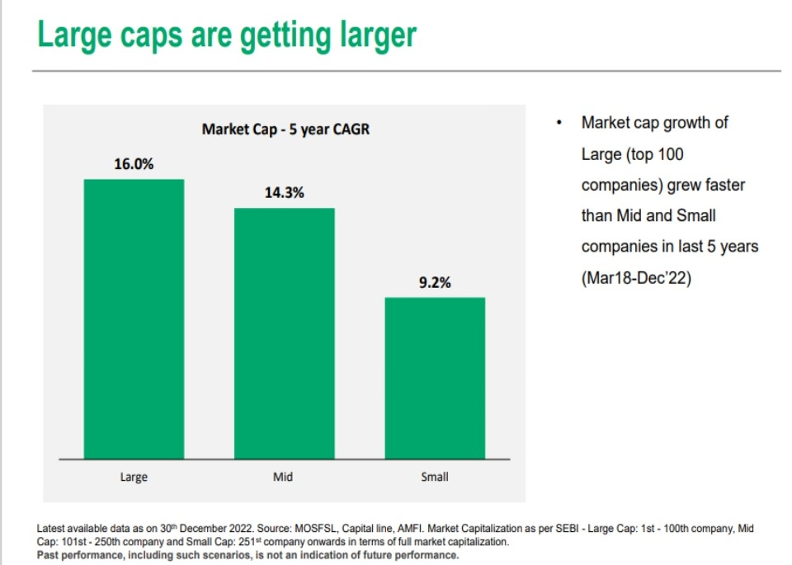
Large cap performance history
Notes:
Data from - Baroda BNP Paribas Large Cap Fund- Jan 2023

Slide 13

Notes:
Data from - Baroda BNP Paribas Large Cap Fund- Jan 2023

Slide 14
5. Who should invest in large cap funds?

Slide 15

Who should invest in large cap funds?
Conservative investors who want diversification in their portfolio
In India still more than 50% conservative investors are there who generally invests their money into bank savings, FD etc. can add mutual fund investments into their portfolio.
Diversification in investment allows allocation of funds across market, sectors and others.
Diversification aims to minimize losses if any sector/security underperforms others may be make up. Each sector, security performs different to each other.

Slide 16

Who should invest in large cap funds?
New investors
Large cap funds looks safer compared to mid cap & small cap. So, new investors can select large cap funds.
Those new investors who may not be familiar with other high volatile securities
to invest into them may select large cap .
By investing in large cap new investors will get exposure to companies which are household names.

Slide 17

Who should invest in large cap funds?
An old people
Large cap funds more suitable to old people.
Large caps are more safer than mid cap & small cap funds.
The main objective of old people is capital protection along with monthly income (little by little they can withdraw) for regular expenses.

Slide 18

Who should invest in large cap funds?
Risk averse investors
Risk-averse investors gives priority to safety of principal over the a higher return.
These investors can select large cap funds as large cap funds can be less volatile compared to mid cap & small cap funds.

Slide 19






Who should invest in large cap funds?
People with long term goals
Marriage
Buy a house
Buy a car
Child education
International trip
Enjoy retirement
People seeking to create long term wealth, large cap funds can provide stability, diversification and potential to earn inflation beating returns to achieve their long term goals.

Slide 20
6. Why invest in large cap fund?

Slide 21

Why invest in large cap fund?
People invests more and more in large caps as less chances of insolvency of
these Cos.
Already established in the market with long term history.
These Co.’s. mostly familiar among people.
Rare chances of Co. will shut down.
Large caps can provide steady growth, they are less volatile than mid cap and small cap.

Slide 22

Why to invest in large cap fund
Financial statements & records are open to public
Financial statement gives snapshot of co.’s financial health at one glance.
This is one of the way by which fund managers, analyst decides to put money into which sector or Co. and which sector to avoid.

Slide 23

Why to invest in large cap fund
Good Corporate governance.
Large caps include top 100 listed Co.s.
Those company's top management involves to enforce corporate governance, which ultimately affects profitability.
The basic principles of corporate governance are accountability, transparency, fairness, responsibility, and risk management.

Slide 24
7. Large cap risk and potential return

Slide 25
Large cap risk and potential return
Potential Return
Small Cap
Lower To Higher
Mid Cap
Focused
Multi Cap
Large & Mid Cap
Large Cap
Lower To Higher
Risk

Slide 26
8. Difference between large cap / mid cap / small cap

Slide 27
Difference between large cap / mid cap / small cap
Illustration | Large cap funds | Mid cap funds | Small cap funds
Liquidity | Good | Moderate | Less
Risk | Low compared to mid & small cap fund | High compared to large cap & low compared to small cap | High compared to large cap & mid cap
Returns | Steady & consistent, can give less returns compared to mid & small cap. | Potential to give high returns if keep longer. | Potential to give high returns compared to large cap & mid cap.
Tenure | Medium to long term | Long term | Long term
Volatility | Less | Moderate | High
Who Should Invest?? | Conservative investors, old people who mostly risk averse. | Those can wait longer tenure with willing to get high returns. | Those expect high returns compared to large & Mid cap with longer tenure.

Slide 28
9. SIP or Lump sum

Slide 29

Different ways of investing money
Systematic investment plan (SIP) is a facility to invest in a disciplined manner.
SIP is similar to a recurring deposit.
In SIP investor can instruct bank to debit the specified amount on specific time interval.
SIP can be done on basis of daily, weekly, monthly, quarterly, half-yearly.
SIP option mostly suitable to regular income investors.

Slide 30

Different ways of investing money
Lump-sum investment means a one time investment.
It requires disposable amount in hand.
Lump-sum investments will be better suited if you are investing at the end of a financial year where investors typically rush to save taxes at end of financial year.

Slide 31

Different ways of investing money
SIP is suitable for those have a steady source of income, whereas if you have ideal funds you should consider lump sum.
SIPs are usually more suited for investment in volatile markets.
Lump sum investments have high returns potential.

Slide 32
10. Tax implication

Slide 33

Tax benefits
Capital gains up to to 1 lakh is totally tax free.
Gains from securities held for more than 12 months fall under tax bracket 10%
When invested less than 1 year, STCG @ 15%

Slide 34

“INVESTMENTS ARE MANTRA OF SUCCESS”

Slide 35


Thank You

